Slide 1
COACHING AS LEADERSHIP
COACHING AS LEADERSHIP
COACHING AS LEADERSHIP

Slide 2
INTRO/
WARM-UP
INTRO/WARM-UP
Right now, turn to another person
and ask about a good thing going
on in their lives right now
-and-
Ask about one good coach they’ve had.
“
“
What is your experience in coaching or being coached?

Slide 3
INTRO/
WARM-UP
INTRO/WARM-UP
“
Coaching is one of the most valuable developmental resources we can offer our workforce, and has been linked to positive outcomes such as increased productivity, retention, and engagement. A successful coaching engagement promotes and sustains professional growth and competence.
- Federal Coaching Network, opm.gov
“

Slide 4
OUTLINE OF REST OF DAY
Identify what coaching is (and is not)
Introduce a model that we can use in our engagement with others: T-GROW
Provide definitions, examples and tools to be used along the way
Application through practice (“real”play)

Slide 5
WHAT IS COACHING?
WHAT IS COACHING?
International Coaching Federation:
“Partnering with clients in a thought-provoking and creative process that inspires them to maximize their personal and professional potential.”
“
It is an experiential development process which facilitates change and growth in both individuals and groups. Through structured dialogue, coaches assist their coachees to see new perspectives and achieve greater clarity about their own thoughts, emotions and actions, and about the people and situations around them.
(FCN FAQ).
“
WHAT IS COACHING?

Slide 6
WHAT IS COACHING NOT
MENTORING
VS
CONSULTING
VS
COACHING
COUNSELING
VS
COACHING
COACHING

Slide 7
WHAT IS A COACH AND A “COACHEE”?
COACHEE: gives power to the relationship, drives the coaching agenda, and is ultimately responsible for the outcome of the coaching engagement.
COACHEE
COACH: applies specific techniques and skills, approaches, and methodologies that enable the coachees to develop their goals and design actions to achieve them. (FCN)
Because the coach doesn’t have to be 'the expert' on the problem, they have the freedom of not having bias as to how to solve a problem.

Slide 8
RESULTS PYRAMID
THE COACHING
“RESULTS PYRAMID”
RESULTS
(Outcomes)
Where have you typically been coached in your experience?
ACTIONS
(Behaviors)
RESULTS PYRAMID
Where do you think the most effective place to begin would be?
WORLDVIEW
Beliefs , Values, Mindset , Identity

Slide 9
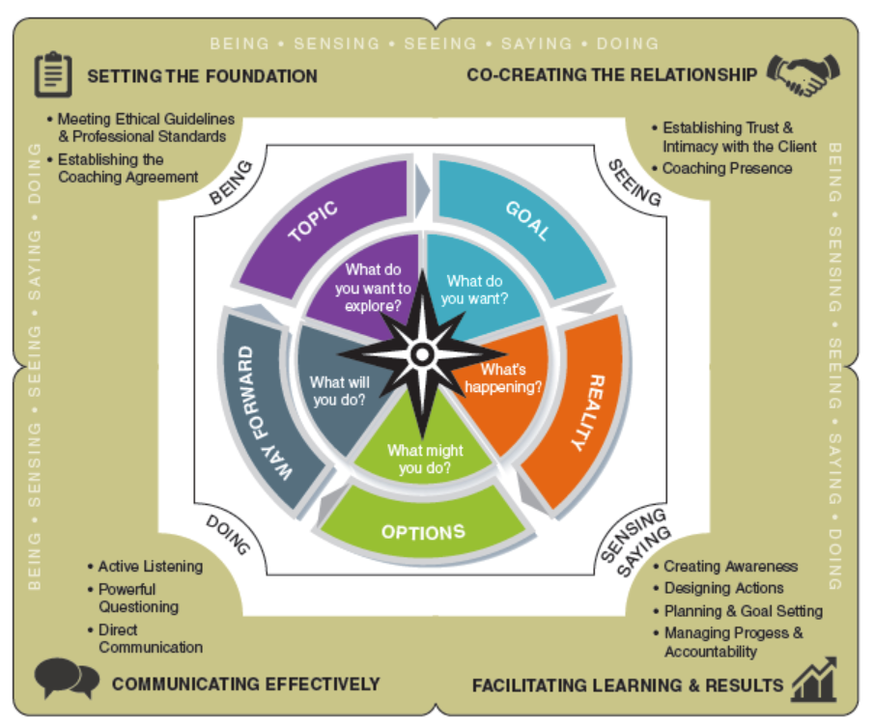
THE T-GROW MODEL FOR COACHING
REALITY
T-GROW
T-GROW

Slide 10
THE T-GROW MODEL FOR COACHING
Initial understanding
TOPIC
Clarity / commitment support
WRAP-UP
For session
GOAL
OPTIONS
REALITY
Who / What / Where / How much?
What’s possible?
T-GROW
T-GROW

Slide 11
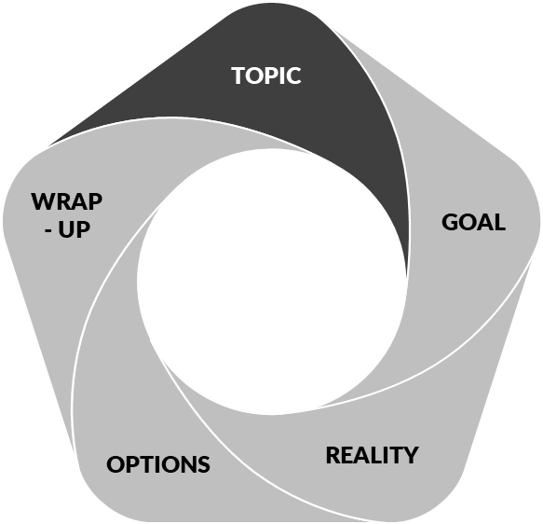
COACHING CONVERSATION MODEL: PART I - TOPIC & GOAL
EXAMPLE FROM THE T-GROW MODEL:
TOPIC - Professional manager or executive looking to improve in the workplace.
GOAL - Improve my approach to working with an individual to realize a better relationship.
TOPIC & GOAL
FOCUS ON APPRECIATIVE INQUIRY
INSTEAD OF “TOPIC”

Slide 12
COACHING CONVERSATION MODEL: PART I - TOPIC & GOAL
APPRECIATIVE INQUIRY: WHAT IT IS AND WHY IT IS IMPORTANT
APPRECIATIVE INQUIRY
We want to focus on past peak performance to leverage experience in order to facilitate a sense of self-efficacy and resourcefulness in the client.
APPRECIATIVE INQUIRY
Or put more simply,
we focus on strengths and prior successes –
not weaknesses.
WkBk pg2

Slide 13
COACHING CONVERSATION MODEL: PART I - TOPIC & GOAL
DIRECTIONALIZING WITH APPRECIATIVE INQUIRY
Work within the TOPIC of the coaching agreement (professional, work-related).
Set the stage by how we ask the question.
Build rapport with the client.
Ask an open ended question founded on curiosity and leverage.
Examples:
"What has the BEST part of your week been?"
INQUIRY
"What has gone well for you this past week?"
"What was the most memorable part of the past few days?"
"How do you feel now that _______ has happened?" [you got the promotion, etc.]
KEY:
We are listening for a VALUE word we can later connect to our GOAL.
13

Slide 14
14

Slide 15
https://www.youtube.com/watch?v=pfHGnCuNqfg
At the end of the video….
What did Pink say about the relationship between “if-then” rewards and creativity?
What two things did Pink say were the secrets to high performance?
15

Slide 16
A MODIFIED
T-GROW MODEL FOR COACHING
Appreciative Inquiry
Mindset
TOPIC
WAY
FORWARD
GOAL
OPTIONS
REALITY
T-GROW
T-GROW

Slide 17
PRACTICE:
PRACTICE:
PRACTICE:
Turn to your partner and ask 2-3 AI questions.
Listen for the VALUE(s) you could use to bring into a coaching session.
PRACTICE:
Write them down.
17

Slide 18
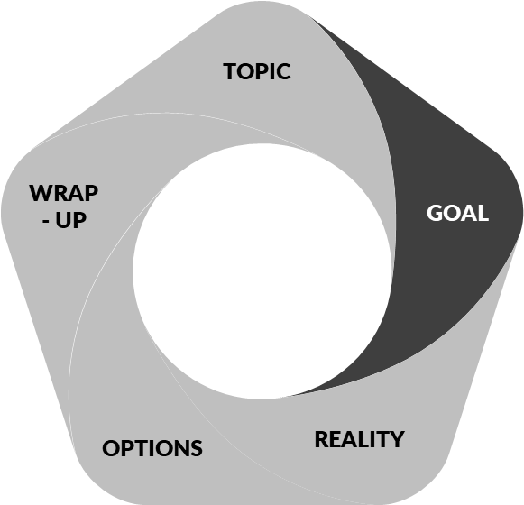
TOPIC & GOAL
COACHING CONVERSATION MODEL:
Part I –
TOPIC & GOAL
AGENDA
What are some sample AGENDA questions you might ask?:
GOAL
Agenda and Evidence
Where do you want to go?
By end of the session, what do you want?
What problem are you trying to solve?
What could we work on that would make a big difference at work?
What do you want to achieve from this conversation?
What would be the best use of our time today?
What’s even more important than this goal?
After identifying the initial AGENDA , identify 2 -3 supporting VALUES.
- If you had [agenda goal], what would it do for you?
- Why is that really important to you?
TOPIC & GOAL
- What would that give you?
WkBk pg3
18

Slide 19
PROCESS TOOL: BACKTRACKING
Use their words back , but ask a helpful question that moves the thought process forward.
Not paraphrasing or “parroting.”
BACKTRACKING
BACKTRACKING
WkBk pg4
19

Slide 20
PROCESS TOOL: BACKTRACKING
NOTE: If the coachee uses negative language, remember–
We are trying to shift mindset to a positive view - a growth mindset that taps into their creativity instead of a fixed mindset. We want to engage their imagination part of the brain that looks at possibilities for what could happen that’s good.
BACKTRACKING
BACKTRACKING
20

Slide 21
PRACTICE:
DEMONSTRATION
Let’s try deepening some Agendas using backtracking and focusing on the bottom of the coaching “results pyramid” to develop some improvement goals.
PRACTICE:
PRACTICE:
Listen for the VALUE(s) you could use to bring into a coaching session.
Write them down.
21

Slide 22
GOAL
COACHING CONVERSATION MODEL:
Part I –
TOPIC & GOAL
Agenda and Evidence
EVIDENCE
Evidence is a scale that we use in the process to measure progress.
“You say you want [goal/outcome].
How will you know when you have it?”
GOAL
“On a scale of 1-10,
where are you now?”
“What is a reasonable number you would like to be
by the end of the session?”
“How would you know you were a [#]?”
22

Slide 23
PUTTING IT TOGETHER
THE TOPIC &
GOAL “SCRIPT”
(3) Backtrack and connect to worldview/values.
(4) Set the Agenda
“If you could have [Agenda goal] and experience more [Value 1] and [Value 2] (so you can have more [core value]), would that be a great use of our time?”
(1) Appreciative Inquiry:
“SCRIPT”
“What has gone well for you this week?”
Listen for potential values that are important to the person and could be used when crafting the Goal.
“If you had [agenda goal], what would it do for you?” -or-
“Why is that really important to you?” -or-
“What would that give you?”
Try to find 2-3 Values that are important to them.
(2) Explore the Agenda:
“By the end of the session, what do you want to have accomplished?”
-or- “What would be a good use of our time today?”
Identify the improvement goal.
(5) Get the Evidence:
On a Scale of 1 to 10, where are you now with [issue] ?
“If at a [#] now, what is a reasonable number you would like to be by the end of the session?”
“How would you know you were a [#]?”
23

Slide 24
A MODIFIED
T-GROW MODEL FOR COACHING
Appreciative Inquiry
Mindset
TOPIC
Agenda and Evidence
Positive
Backtracking
WAY
FORWARD
GOAL
OPTIONS
REALITY
T-GROW
T-GROW

Slide 25
GOAL
Topic:
Appreciative Inquiry
PRACTICE WITH PARTNER USING YOUR CHECKLIST
Goal
Agenda Question
Backtrack: Connect to Worldview
REPORT OUT.
Evidence: Now & End
TOPIC
WkBk pg5
25

Slide 26
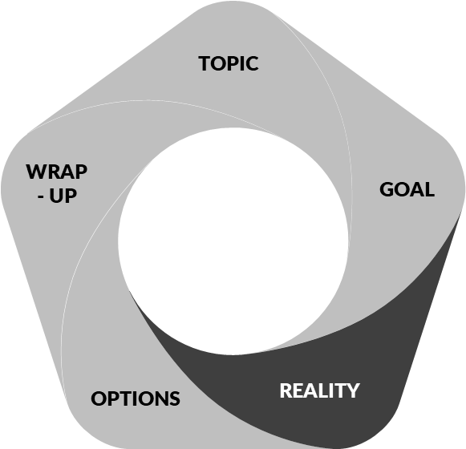
REALITY
COACHING CONVERSATION MODEL:
Part II - REALITY
REALITY
1
Understanding the NOW is helpful. Dwelling on it hijacks our ability to envision the future.
KEY
2
You need fewer details than you probably think you do!
KEY
3
Assume that client has all the resources they need to solve the problem.
NOTE: This can be one of the most dangerous parts of the journey.
Instead of spending a lot of time in the REALITY portion of the model, we simply use REALITY as a pivot.
KEY
26

Slide 27
QUESTIONS
SO WHAT ARE SOME QUESTIONS YOU COULD ASK TO HELP THEM UNDERSTAND THE BIG PICTURE?
What’s happening now?
What have you done about it so far?
How is this impacting you?
QUESTIONS
If things don’t change, what is likely to happen?
What’s the challenge in this for you?
What are the key barriers to improving
this situation?
27

Slide 28
A MODIFIED
T-GROW MODEL FOR COACHING
Appreciative Inquiry
Mindset
TOPIC
Agenda and Evidence
Positive
Backtracking
WAY
FORWARD
GOAL
Present State.
A pivot at the most; or move to Options
REALITY
OPTIONS
T-GROW
T-GROW

Slide 29
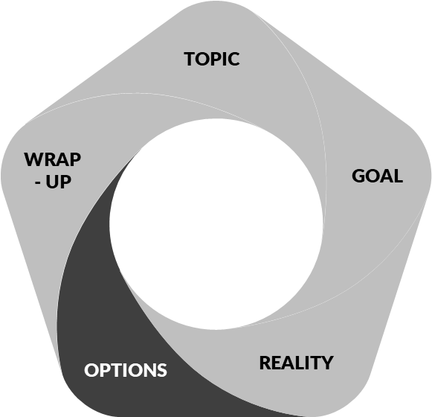
COACHING CONVERSATION MODEL:
Part III - OPTIONS
OPTIONS
Future Casting
DESIRE :
“What do you want? Describe it.”
Or “Imagine that sense of [value],
as if you’ve already succeeded.
What does it feel like? look like?”
Help them flesh out a
Future Vision:
MEANS :
“How did you get it? What was your plan?” // "Imagine you succeeded...What are those steps? What might that outcome be?”
OPTIONS
OPTIONS
ACHIEVEMENT :
“How will you know you've got it?” “Describe the impact on you, others, etc.”
“How will you celebrate?”
WILL :
“How did you commit to that?”
“Why is that important?”
OPTIONS

Slide 30
COACHING ZONES
VISION:
Who else or what else outside of self are you doing this for? That is, for what Greater Purpose?
TOOL SET:
COACHING ZONES
IDENTITY:
“When you [achieved your goal] or [living that ideal picture], who are you in that moment?”
ENVIRONMENT:
“When/Where/With whom will this happen?”
CHOICES /INTENTIONS:
“What going to have to say yes to?” What will you have to say ‘no’ to?”
ACTIONS/BEHAVIORS:
“How did you achieve this?” “What specific actions did it require?” “What will your First Steps be?” Backwards Planning.
VALUES
“Why is that important?” “What will that give you that’s even more meaningful? “What’s going to drive you? Enrich you? Fulfill you?”
CAPABILITIES:
What skills did you have to obtain / maintain to get there?
COACHING ZONES
WkBk pg9
30

Slide 31
KEYS:
TOOL SET:
COACHING ZONES
KEYS:
KEYS
While in a coaching session, take note of which zones you have focused on and ensure you hit the others; don’t camp on a single level (or two).
Ask yourself, “In which zone are they, and in which zone should I be coaching them?”
When stuck, look one zone right/left on the dial.
31

Slide 32
QUESTIONS
TOOL SET: OPEN ENDED QUESTIONS
VAK - Visual, Auditory, Kinesthetic Questions
VISUAL :
KINESTHETIC :
What do you see?
What does that look like?
What’s in the distance?
Horizon, observe, focus, perspective, outlook, reflect, beautiful, bright, dark
Clear as mud, foggy, turn blind eye, rosy picture, wolf in sheep’s clothing
How does that feel?
Feel in my gut. Bowels. Temperature. Pressure. Direction. Steady or intermittent. Bumpy/ smooth; steady/off balance; hold onto that, heartbreaking. Stay in touch, feeling for you, walk into something, experience it, hold onto, pulling the strings, take pressure off, walk on eggshells
AUDITORY:
QUESTIONS
How does that sound?
How does that resonate?
Tell me. Share. Right wavelength. Volume, heard, noise, silent, fade, ring a bell, shout, echo.
KEY: LISTEN TO HOW THEY SPEAK
WkBk pg10
32

Slide 33
TOOL SET: OPEN ENDED QUESTIONS
(continued)
OPEN-FRAMES
Might–
How might you get it? Who might be able to help?
Begin-
What is the first step? How might you begin?
Leverage
What’s working? Greatest impact? How might you use x to get y? What strengths do you have?
QUESTIONS
SYSTEMS –
A.W.E. -
How would you sustain this? optimize it? organize and maintain it? How does it fit in your life/world?
Think: how could they systematize? optimize? align?
“And What Else?”
QUESTIONS
33
WkBk pg11

Slide 34
A MODIFIED
T-GROW MODEL FOR COACHING
Appreciative Inquiry
Mindset
TOPIC
Positive
Backtracking
Agenda and Evidence
WAY
FORWARD
GOAL
Present State.
A pivot at the most; or move to Options
Future Casting
Coaching Zones
Open-ended Questions
REALITY
OPTIONS
T-GROW
T-GROW

Slide 35
PRACTICE:
Get back with your partner and ask questions based on previous GOAL they brought up.
Remember the basic flow for Future Casting
DESIRE: “What do you want?” “Describe it to me.”
MEANS: “How did you get it?” “What was your plan?”"Imagine you succeeded, as if you took steps to effect a great outcome. What are those steps? What might that outcome be?”
WILL: “How did you commit to that?” “Why is that important?”
ACHIEVEMENT: “How will you know you've got it?” “Describe the impact on you, others, etc.” “How will you celebrate?”
2. Note which Coaching Zones you have hit. Hit each Zone with at least one question.
3. Get curious and have fun! Simply access the “Open Ended Questions” to help, not as a script.
Report out.
PRACTICE
WkBk pg13-14
35

Slide 36
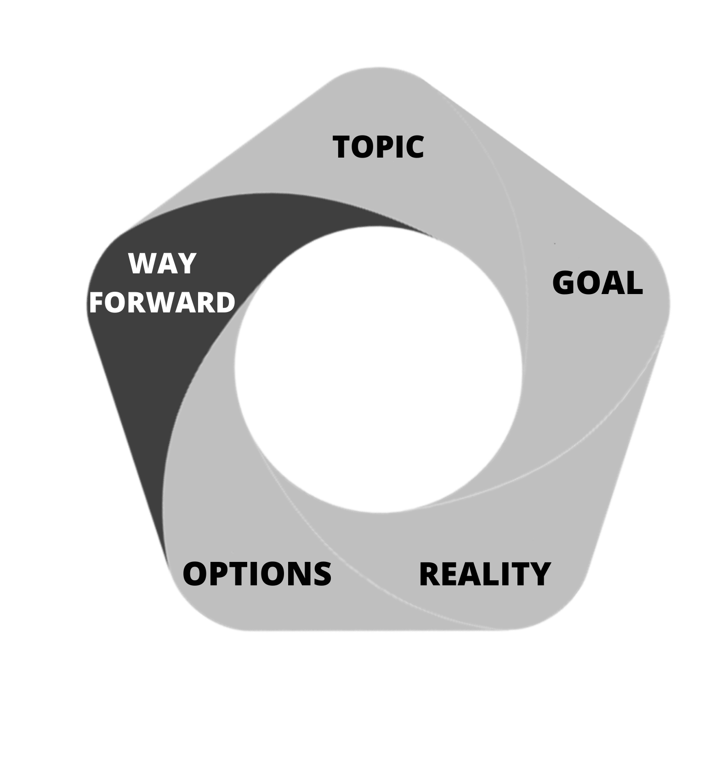
COACHING CONVERSATION MODEL:
Part IV - WAY FORWARD
It helps give them a concrete sense of how to begin moving closer to their goal…and it wraps it up for both of you.
One of the easiest transitions can simply be “Looking at the time…”
We’re going to break this into two parts - the WAY - and the FORWARD.
WkBk pg15

Slide 37
WAY - addresses action, accountability and evidence.
“This is the way we’re going to accomplish our goal.”
03
01
02
EVIDENCE
We simply return to our scale from the GOAL component.
ACTION STEPS
ACCOUNTABILITY
We want the client to leave with one to three (1-3) ACTION STEPS they are going to take to “move forward from their goal.”
“We’ve discussed quite a few options to help you move forward in accomplishing ‘_____’. What are the first steps you intend on taking?”
How do you plan on making sure you’ll take those first steps?
Who can help you maintain accountability to begin implementing this plan?
“
With the insights you’ve had, and the steps you plan on implementing, where would you say you are at this time on that scale of 1 to 10?
“
BONUS
A great question to take it to the next level:
If they are a [#] and a half - “What would it take to get you to a [#]?”
OR they are a [#] - “What would it take to
get you to a [#]+1?”

Slide 38
FORWARD
refers to how we move forward from this session with a client, and it has two components:
MOST VALUABLE TAKEAWAY (MVT)
“What are you taking away from today’s session that you feel has been most valuable?” OR
“What was your biggest ‘Aha!’ that will help you moving forward?”
APPRECIATION: share something you genuinely admire about them
“I’d just like to say that I really appreciate [your level of authenticity] today. I believe it will continue to serve you as you move forward to take the first steps to (you can mention what they listed above here).”
“I’ve enjoyed our time today and admire [your commitment to constantly improve]. With your permission, I’d like to contact you next week and check-in to see the impact of you implementing your first steps.”

Slide 39
A MODIFIED
T-GROW MODEL FOR COACHING
Appreciative Inquiry
Mindset
Way
Action Steps
Accountability
Evidence
Forward
MVT
Appreciation
TOPIC
Agenda and Evidence
Positive
Backtracking
WAY
FORWARD
GOAL
Present State.
A pivot at the most; or move to Options
Future Casting
Coaching Zones
Open-ended Questions
OPTIONS
REALITY
T-GROW
T-GROW

Slide 40
PRACTICE:
TOPIC/ APPRECIATIVE INQUIRY:
-”What has gone well for you this past week?”
-”How might we take that same presence/energy into our session today?”
GOAL
AGENDA:
-”In thinking of a goal or outcome, what would make this an amazing session for you?”
Listen for Outcome:_____________________________.
- “If you had [Outcome], what would that mean for you?”
Listen for VALUE #1:_____________
- What would [Value #1] do for you that might be even more important?
Listen for VALUE #2:_____________
- “If you had that fully and completely what would that give you that is deeper and more important?”
If ask a third time, listen for a CORE VALUE:________________
- “So, if I could assist you to get [OUTCOME], so that you could have more of [VALUE #1], and [VALUE #2] (and CORE VALUE), would that be a good use of our time? [Y/N]
EVIDENCE:
- “Thinking about where you are, on a scale of 1 to 10, how would you rate your (ability, confidence, etc.) to [achieve their desired OUTCOME]?” ___(#)___
- “By the time we're finished, where do you think you’d reasonably like to be?” ___(#)___
- “How will you know?” __________________
REALITY
Ask just a couple questions – or move right to “Options”
- “What have you done about it so far?” -or-
- “How is this impacting you?” –or-
- “If things don’t change, what is likely to happen?” -or-
- “What’s the challenge in this for you?”
OPTIONS
FUTURE CASTING
Pull from Coaching Zones and Open-Ended questions
DESIRE: “What do you WANT? (see it on the wall) Imagine that sense of [value], as if you’ve already succeeded. Tell me what that looks like? feels like?”
MEANS: “How did you get it? What was your plan?”
WILL: “How did you commit to that? Why is that important?”
ACHIEVEMENT: “How will you know you've got it?”
“Describe the impact on you, others, etc.”
“How will you celebrate?”
Note what coaching zones you are able to address along the way and try to fill any gaps in the coaching zones.
WAY FORWARD
“Looking at the time, I want to ensure we leave some time to look at the way forward …”
WAY
Action Steps: “What are the next 1-3 steps you will take?”
Accountability: “How will you ensure you take those steps? Who will keep you accountable?”
Revisit Evidence: “With the insight you’ve had and steps you’ve identified, where would you say you are at this point on that scale of 1 to 10?”
FORWARD
- MVT: What is the most valuable thing you are taking from this?”
- Appreciation: “I’ve enjoyed our time today and admire [_______]. With your permission, I’d like to contact you next week and check-in to see the impact of you implementing your first steps.”
PRACTICE
40

Slide 41
COACHING AS LEADERSHIP
COACHING AS LEADERSHIP
COACHING AS LEADERSHIP

Slide 42
Kermit Jones, Jr.
kermit.jones@sightpicture.global
Emile Moured
emile.moured@sightpicture.global
Downloads: sightpicture.global/cal1pg or cal4pg
Other Options:
Public Speaking
Leverage Your Leadership Style
Building Trusting Teams
Coaching as Leadership
Immunity to Change

