Slide 2
20-60-20 Rule

Slide 3
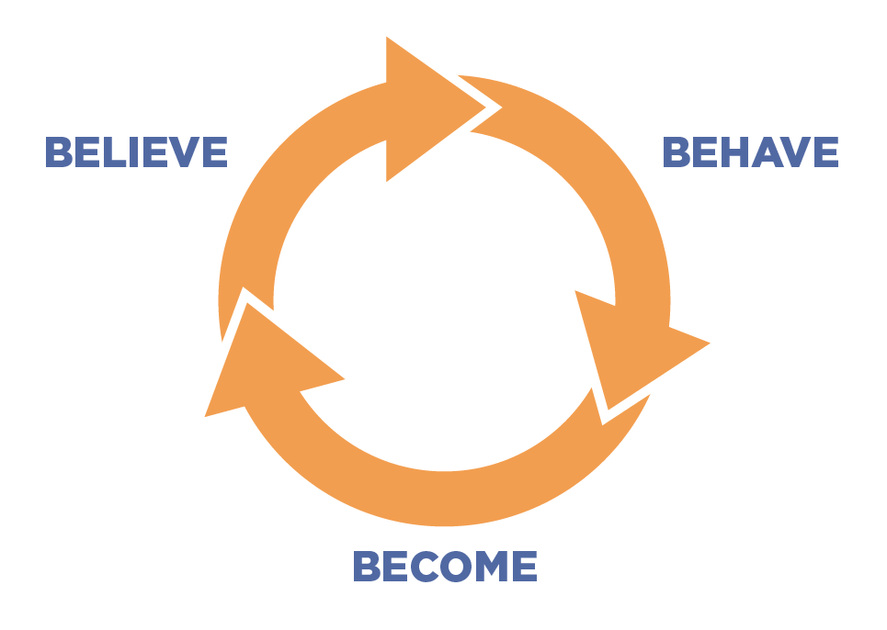

Slide 4
Assess Your Temperament
Step 1: Postcards Picture Side Up of Activities & Interests
Like Most Like Least
Arrange the cards in order of your interest from most to least

Slide 5
 | GOLD | GREEN | BLUE | ORANGE
STEP 1 | 3 | 1 | 2 | 4
STEP 2
STEP 3 | D | B | C | A
TOTAL

Slide 6
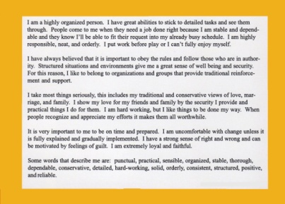
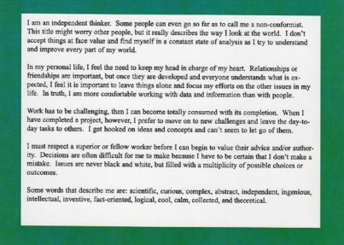
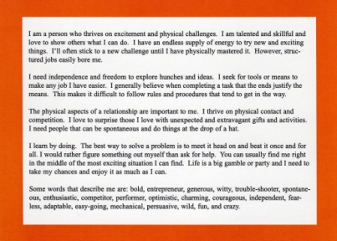
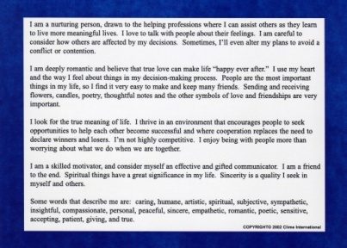
Assess Your Temperament
Step 2: Postcards Color Border Side Up of Written Descriptions
Like Most Like Least
Arrange the cards in order of your interest from most to least

Slide 7
 | GOLD | GREEN | BLUE | ORANGE
STEP 1 | 3 | 1 | 2 | 4
STEP 2 | 4 | 1 | 2 | 3
STEP 3 | D | B | C | A
TOTAL

Slide 8
1. When I have to make a decision......
4 a.
3 b.
1 c.
2 d.

Slide 9
1. When I have to make a decision......
4 a.
3 b.
1 c.
2 d.

Slide 10
Scoring Your Preferences
 | GOLD | GREEN | BLUE | ORANGE
STEP 1
STEP 2
STEP 3 | D | B | C | A
TOTAL

Slide 11
 | GOLD | GREEN | BLUE | ORANGE
STEP 1 | 3 | 1 | 2 | 4
STEP 2 | 4 | 1 | 2 | 3
STEP 3 | D 39 | B 17 | C 17 | A 27
TOTAL

Slide 12
GOLD
GREEN
BLUE
ORANGE
STEP 1
3
1
2
4
STEP 2
4
1
2
3
STEP 3
D 39 B 17 C 17 A 27
TOTAL
46
19
21
34

Slide 13
GOLD
GREEN
BLUE
ORANGE
STEP 1
3
1
2
4
STEP 2
4
1
2
3
STEP 3
D 39 B 17 C 17 A 27
TOTAL
46
19
21
34
TOTAL = 120

Slide 14
Temperament Teams
In your assigned Temperament Teams, build a presentation for the class that educates us on what it’s like to live in your primary temperament.
Consider each of the four areas: Values, Joys, Needs and Strengths.
Take 10-15 minutes to build the presentation and be prepared to enlighten us on what it’s like to be you!
Have fun!

Slide 15
Capture key ideas

Slide 16
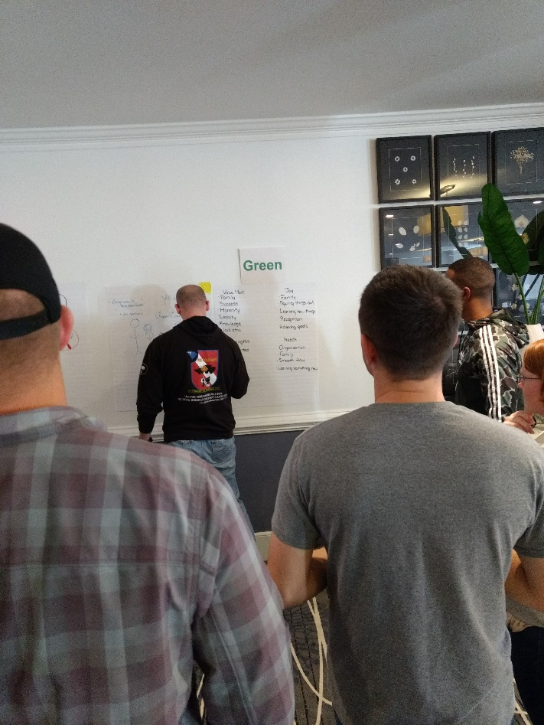
Presenting Posters
Your turn!
Values
Joys
Strengths
Needs

Slide 17
Primary Temperament Debriefs
Green Blue Gold Orange

Slide 18
POLL: MBTI Assessment
I’ve never taken MBTI.
I’ve completed MBTI but forgot my code.
I remember my code & only partly what it means.
I remember my code & can explain what it means.
I can explain what all the MBTI codes mean (others).

Slide 19
Myers-Briggs Correlation

Slide 20
LEFT
RIGHT
Competence
Freedom
Order/Structure
Relationships

Slide 21
Activity
What do you think are the primary preferences of the most important people in your life?
Capture on page 9 the names of these people
Based off what you have learned today, what would be their primary preference?
On page 10 take a moment and identify what you might do for each to build or strengthen these relationships?

Slide 22
Plotting Your Preferences

Slide 23
Plotting Your Preferences
Your spectrum is: 32% Orange 31% Green 23% Blue 14% Gold
40
Green
30
Orange
20
10
Gold
Blue

Slide 24
Strengths
Your spectrum is: 32% Orange 31% Green 23% Blue 14% Gold
40
Green
30
Orange
20
10
Gold
Blue

Slide 25
Blindspots
Your spectrum is: 32% Orange 31% Green 23% Blue 14% Gold
40
Green
30
Orange
20
10
Gold
Blue

Slide 26
Teamwork
Your spectrum is: 32% Orange 31% Green 23% Blue 14% Gold
40
Green
30
Orange
20
10
Gold
Blue

Slide 27
Teamwork
Your spectrum is: 32% Orange 31% Green 23% Blue 14% Gold
40
Green
30
Orange
20
10
Gold
Blue

Slide 28
Maturity Continuum
Others
Humility
High Maturity
Self
Pride
Low Maturity

Slide 29
Maturity Continuum
Others
Humility
High Maturity
Self
Pride
Low Maturity

Slide 30
The Million Dollar Question
Where do your actions align?
Low Maturity
Pride
Self
High Maturity
Humility
Others

Slide 31
Which Wall Are You Facing?
Low Maturity
High Maturity

Slide 32
Which wall Are You Facing?

Slide 33
Where are you? Which wall Are You Facing?

Slide 34
Maturity—Key Principles
You are moving toward whichever wall you are facing (energy and time).
The default wall is the low-maturity wall.
Moving toward higher maturity will take deliberate work, effort, and high self- awareness. It does not simply happen as you age.

Slide 35
Breakout – Low Maturity
In your Temperament Groups
In your temperament group, brainstorm and create a POSTER to share with the group what Low Maturity looks like for that preference either at home or at work.
Use your real-life behaviors, not “I know a friend” behaviors.

Slide 36
Group Activity – High Maturity
Let’s create a list of High Maturity by temperament?

Slide 37
LOW MATURITY
It’s all about ME!
Rules don’t apply
Ruled by their “gut”
Live “in the moment”
Arrogant
Prideful
“Above it all”
Judgmental
Play too small, play too big
Often gives in to others
Emotional
Difficulty achieving goals
Control freaks
Hold onto the status quo
Lack flexibility
My way or the highway

Slide 38
HIGH MATURITY
Expertise
Visionary
Ask thoughtful questions
Consequences— all of them
Explore/see the possibilities
Creates action
Energize us!
Team player
Effective communicator
Full team involvement
Respectful
Skilled motivator
Follow the process
Stay on time/task
Focus on the result
Institutionalize best practices

Slide 39
Temperament Tips

Slide 40
MOTIVATION
Understanding what drives each personality temperament will help you learn how to more effectively motivate people to invest in each other, experience creativity, and give their best work toward a common goal.

Slide 41
MOTIVATION STRATEGIES
Develop motivators and motivational strategies for each 4 Lens color modifier as pipelines that fill a boiler that drives a power plant, use real life examples if possible.
In groups of 3-5: For your assigned 4 Lenses color, reflect on what you have already learned to develop up to 8 motivation strategies that might speak specifically to someone of that personality temperament.

Slide 42
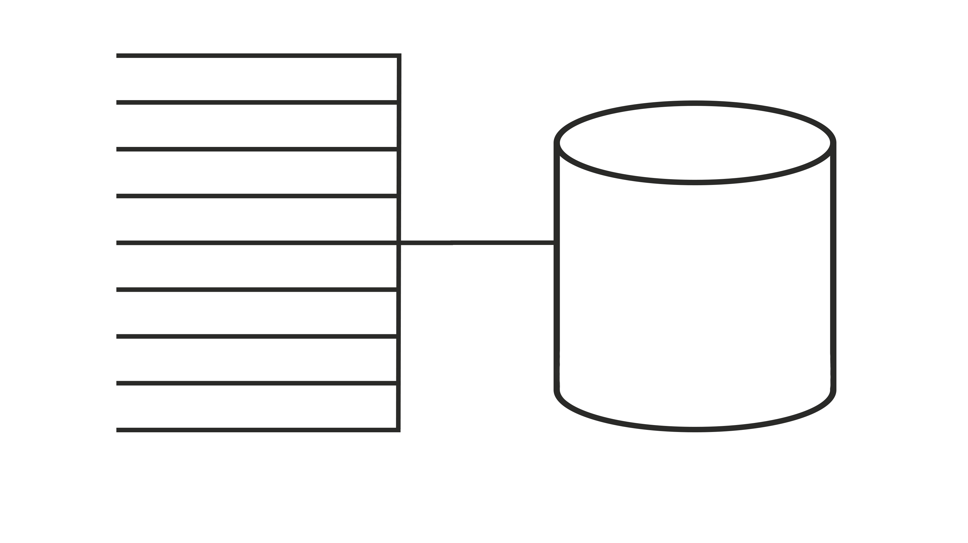
MOTIVATING BLUES
Praise their contributions
Acknowledge their significance
Support their intuition
Give personal attention
Encourage creativity
Promote social activities
Recognize their individuality
Reward with sincere appreciation
Consider someone in your life who might be blue. Which motivational strategies might you try? How specifically might you employ that strategy in that situation?

Slide 43
MOTIVATING GOLDS
Praise their judgement
Recognize their dependability
Place them in charge
Involve them in planning
Give them responsibilities
Give consistent feedback
Let them organize things
Reward with public recognition
Consider someone in your life who might be gold. Which motivational strategies might you try? How specifically might you employ that strategy in that situation?

Slide 44
MOTIVATING GREENS
Praise their insight
Recognize their expertise
Involve them in decisions
Explain the overall picture
Support their ideas in public
Encourage new ideas
Appreciate their uniqueness
Reward with independence
Consider someone in your life who might be green. Which motivational strategies might you try? How specifically might you employ that strategy in that situation?

Slide 45
MOTIVATING ORANGES
Praise their achievements
Recognize their performance
Offer tangible rewards
Focus on finished products
Appreciate their skill
Give opportunities to perform
Give immediate feedback
Reward with physical freedom
Consider someone in your life who might be orange. Which motivational strategies might you try? How specifically might you employ that strategy in that situation?

Slide 46
What strategies do you already do well?
What strategies come difficult for you?
What strategies did you highlight that you might try?

Slide 47
LEADERSHIP STYLES
Understanding myself

Slide 48
Extroverts and Introverts
Let’s try to guess where each person is on the E-I scale based on the morning workshop
Do introverts or extroverts make the best leaders?
What did you learn during this exercise about yourself? About others?
What comes naturally and energizes you? What takes intentionality & energy and may therefore be an innate blind spot?

Slide 49
Individual Leadership Personality Style Descriptions
Read your individualized personality style description.
As you read through it, note those things that describe your personality style and help articulate or bring understanding to things you may have noticed about yourself.
Note those things you feel may not describe you and how you might say you are different. This is just a tool, not a crystal ball.

Slide 50
Individual Leadership Personality Style Descriptions
In groups of 3: Interview each person one at a time and try to understand their leadership style.
If sharing, please draw from personal examples to explain your leadership personality.
If interviewing, you might ask the interviewee to explain their leadership personality style, how this has affirmed something they may have already known about themselves, and if this brought to light something they didn’t know about themselves.

Slide 51
LEADING OTHERS

Slide 52
Leadership Strategies
In groups of 3-5: Take the next 40 minutes to devise leadership strategies that might help you deal with the three topics below for your assigned color(s):
Show Appreciation. We know everyone wants to be appreciated. How can you show appreciation in accordance with their personality preferences?

Slide 53
Leadership Strategies
Deal with Procrastination.
What reasons/excuses might someone offer with a certain personality preference?
What strategies might you use to overcome procrastination by understanding those unique reasons?

Slide 54
Leadership Strategies
Enhance Teamwork. Everyone views teamwork differently.
How might someone of your assigned color view or value teamwork?
Based on this new understanding, how could you as a leader invite someone with those personality preferences to become a more invested member of a team?
Prepare to report out your discoveries and strategies to the rest of the group.

Slide 55
Recognize and compliment their capabilities and competency.
Be direct and specific, and avoid flowery talk that could sound patronizing.
Offer recognition on issues important to Greens, such as:
Displaying expertise on a topic; being the “SME”
Working overtime or putting in extra effort on their own initiative
Formulating logical arguments
Troubleshooting problems
Thinking outside the box
Recognize the grace, style, smoothness with which they get the job done.
Praise them for being willing to take risks.
When offering praise, highlight Orange qualities such as:
Demonstrating courage and confidence, especially in crisis
Being bold and candid when necessary
Adapting well to changes
Looking good under pressure
Tackling challenges head-on
LEADING OTHERS
Showing Appreciation
Highlight good things about the product, its quality or its quantity.
Focus on something a Gold made or did.
Topics that are usually meaningful to Golds include:
Fulfilling commitments and obligations
Attention to detail, neatness, orderliness
Punctuality and preparedness
Adhering to rules and requirements
Respect, loyalty, and preserving the institution
Offer compliments and appreciation that comes from the heart.
Lead with praise, not criticism.
Offer recognition and validation on topics important to Blues, such as:
Accommodating requests gracefully
Contributing to morale and well-being
Making peace between people
Being compassionate or welcoming
Participating or leading worthy causes

Slide 56
Excuse(s):
“This is too [repetitive; touchy-feely]. Give me some problem solving!”
Strategies:
Focus on this as a problem to be solved with elegance so people will be mystified as to how it was done so well and so quickly!
Resource out some of the “personal” or mundane tasks, if possible, to allow Greens to focus on the problem solving aspects.
Excuse(s):
“Planning is boring. Let’s get to the action!”
“You worry too much. It’ll all work out in the end!”
Strategies:
Focus on the problem as an obstacle waiting to test you! Plus, the quicker you finish, the quicker you get on to what’s fun!
Make the task fun, kinetic and challenging.
Gameify it!
LEADING OTHERS
Dealing with Procrastination
Excuse(s):
“It has to be perfect! . . . [and I don’t know if I can make this one perfect . . . so I’ll focus on a task I know I can get done well!]”
“This is a waste. It doesn’t help the organization.”
Strategies:
“The enemy of ‘good’ is ‘perfect’.” “Good” is an acceptable state!
Tie-in immediate efforts to larger goals of the organization.
Excuse(s):
“Caring for people and maintaining harmony are more important.”
Strategies:
Emphasize how the project will allow Blues to help others.
Illustrate how the project will pull people together and create unity.

Slide 57
View: “Teamwork may be necessary and even enjoyable, but either help me accomplish the mission or get out of the way.”
Strategies:
Give clear roles and expectations, but give Greens the freedom to define processes as needed.
When possible, avoid giving Greens redundant detail work and try to utilize their creative problem-analysis or problem-solving.
View: “Teamwork is a love-hate function. Let’s organize, but then let’s move out and not get too bogged down in details!”
Strategies:
Try to tap into Oranges’ natural inclinations to be presenters and deal closers. If you have a crisis that requires short-fused planning and execution, Oranges will typically rise to the challenge.
Keep it light…and keep it moving!
LEADING OTHERS
Enhancing Teamwork
View: “If there are clear roles, this can work. But don’t put me in a team and expect me to do all the work.”
Strategies:
Provide clear goals, expectations and tasks so that the work is distributed fairly. Consider times where Golds might work best independently.
Take time to recognize individual merit and not just the results of the group as a whole.
View: “Since it’s about ‘people’, teamwork makes the dream work!”
Strategies:
Remember Extroversion-Introversion – Blues may prefer small or large groups.
Provide clear goals and expectations, as this reduces friction and conflict – the bane of Blues.
Allow Blues to get to know others on the team before jumping in.

Slide 58
TAKEAWAYS

Slide 59
EMILE.MOURED@SIGHTPICTURE.GLOBAL

